Slide 1
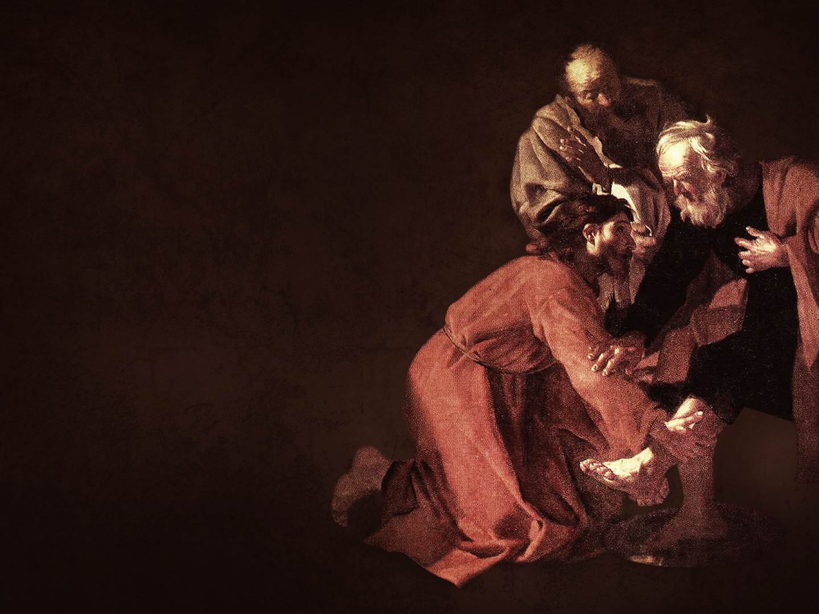
You Be Like Jesus
John 13

Slide 2
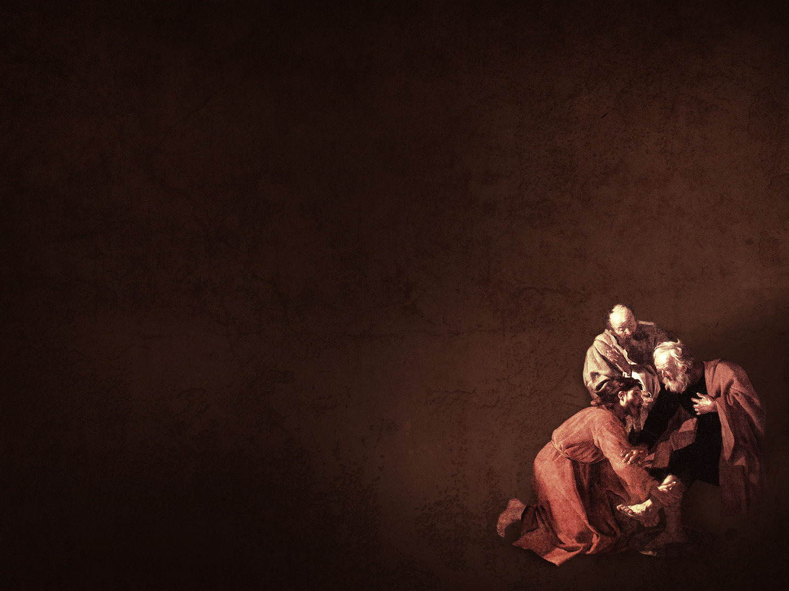
Jesus In John 13
Focused On The Big Picture vs. 1-4
Served First vs. 5-12
Demanded Humility vs. 13-16, 33-35

Slide 3
Rom
When To Be Like Jesus
In Offering Forgiveness Matthew 18:15-17
In Our Relationships Ephesians 5:22-33
In Helping Those In Need Romans 12:9-13

Slide 4
Rom
How To Be Like Jesus
Humbly Think Of & Put Others First Philippians 2:3-8
Focus On Where You’re Going John 13:1-4
Sacrifice For Someone… Today!

