Slide 2
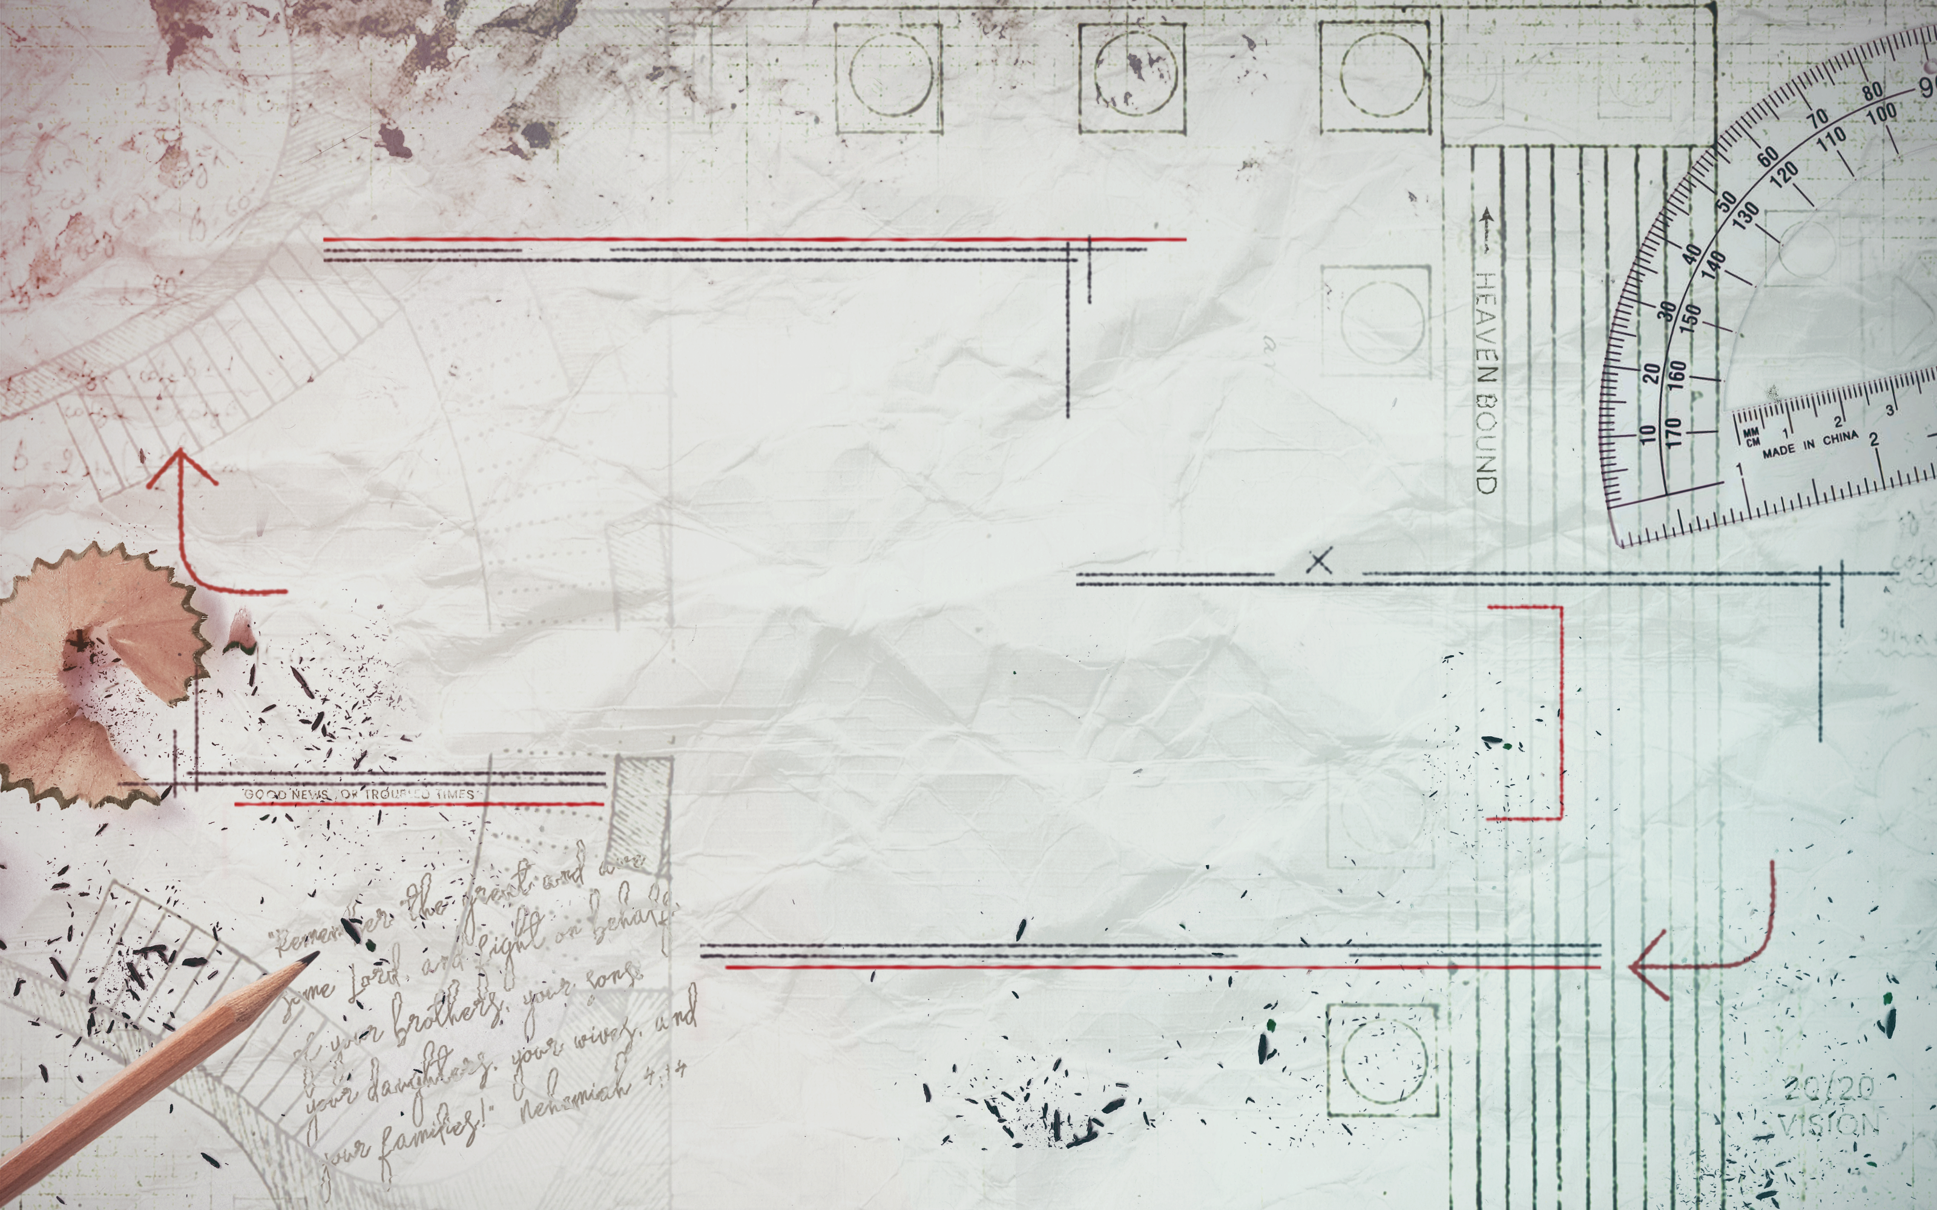

Slide 3
Jesus doesn’t just see crowds of people, He sees people in crowds.
“Your eyes saw my unformed body; all the days ordained for me were written in your book before one of them came to be.” Psalm 139:16
“She gave this name to the Lord who spoke to her: ‘You are the God who sees me.’” Genesis 16:13
“The Lord is watching everywhere, keeping his eye on both the evil and the good.” Proverbs 15:3
DO YOU SEE WHAT I SEE?

Slide 4
ROMAN CENTURION
JESUS SEES YOU WHEN YOU’RE DESPERATE
“So when he heard about Jesus, he sent elders of the Jews to Him, pleading with Him to come and heal his servant. And when they came to Jesus, they begged Him earnestly, saying that the one for whom He should do this was deserving.” Luke 7:3,4
“And those who were sent, returning to the house, found the servant well who had been sick.” Luke 7:10

Slide 5
HEARTBROKEN MOM
JESUS SEES YOU WHEN YOU’RE GRIEVING
“When the Lord saw her, His heart overflowed with compassion.” Luke 7:13
The world is concerned about the crowd;
Jesus is concerned about you.

Slide 6
JOHN THE BAPTIZER
JESUS SEES YOU WHEN YOU DOUBT
“The disciples of John the Baptist told John about everything Jesus was doing. So John called for two of his disciples, and he sent them to the Lord to ask him, ‘Are you the Messiah we’ve been expecting, or should we keep looking for someone else?’” Luke 7:18, 19
“Jesus answered and said to them, ‘Go and tell John the things you have seen and heard: that the blind see, the lame walk, the lepers are cleansed, the deaf hear, the dead are raised, the poor have the gospel preached to them.’” Luke 7:22
John’s circumstances
were difficult.
Jesus’ methods
were inexplicable.
“Lord, I believe.
Help my unbelief.”

Slide 7
THE PHARISEES
JESUS SEES YOU WHEN YOU’RE PLAYING GAMES
“‘To what can I compare the people of this generation?’ Jesus asked. ‘How can I describe them? They are like children playing a game in the public square. They complain to their friends, “We played wedding songs, and you didn’t dance, so we played funeral songs, and you didn’t weep.”’” Luke 7:31, 32

Slide 8
SIMON THE PHARISEE
JESUS SEES YOU WHEN YOU’RE BROKEN
“When one of the Pharisees invited Jesus to have dinner with him, he went to the Pharisee’s house and reclined at the table.” Luke 7:36

Slide 9
SIMON THE PHARISEE
JESUS SEES YOU WHEN YOU’RE BROKEN
“A woman in that town who lived a sinful life learned that Jesus was eating at the Pharisee’s house, so she came there with an alabaster jar of perfume. As she stood behind him at his feet weeping, she began to wet his feet with her tears. Then she wiped them with her hair, kissed them and poured perfume on them.” Luke 7:37, 38

Slide 10
SIMON THE PHARISEE
JESUS SEES YOU WHEN YOU’RE BROKEN
“When the Pharisee who had invited him saw this, he said to himself, ‘If this man were a prophet, he would know who is touching him and what kind of woman she is that she is a sinner.’” Luke 7:39

Slide 11
SIMON THE PHARISEE
JESUS SEES YOU WHEN YOU’RE BROKEN
“Then Jesus answered his thoughts. ‘Simon,’ he said to the Pharisee, ‘I have something to say to you…’” Luke 7:40

Slide 12
SIMON THE PHARISEE
JESUS SEES YOU WHEN YOU’RE BROKEN
Simon saw a problem,
Jesus saw a person.
Simon saw a nuisance,
Jesus saw a need.
“Then he turned toward the woman and said to Simon, ‘Do you see this woman?’” Luke 7:44
Simon saw a situation to avoid,
Jesus saw an opportunity to help.
Simon saw her weakness,
Jesus saw her faith.

Slide 13
For every hurt,
Jesus is our hope.
“For in him all things were created: things in heaven and on earth, visible and invisible. He is before all things, and in him all things hold together.” Colossians 1:16, 17
“For our citizenship is in heaven, from which we also eagerly wait for the Savior, the Lord Jesus Christ.” Philippians 3:20
DO YOU SEE WHAT I SEE?

