Slide 1
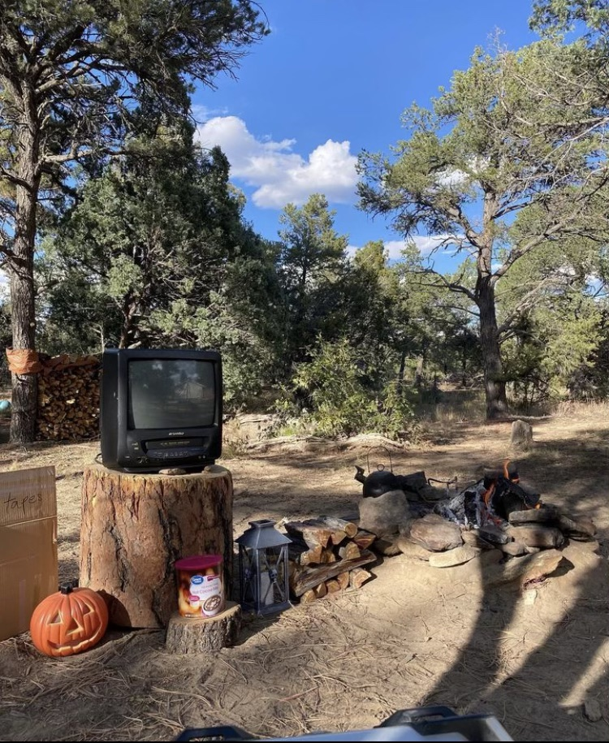
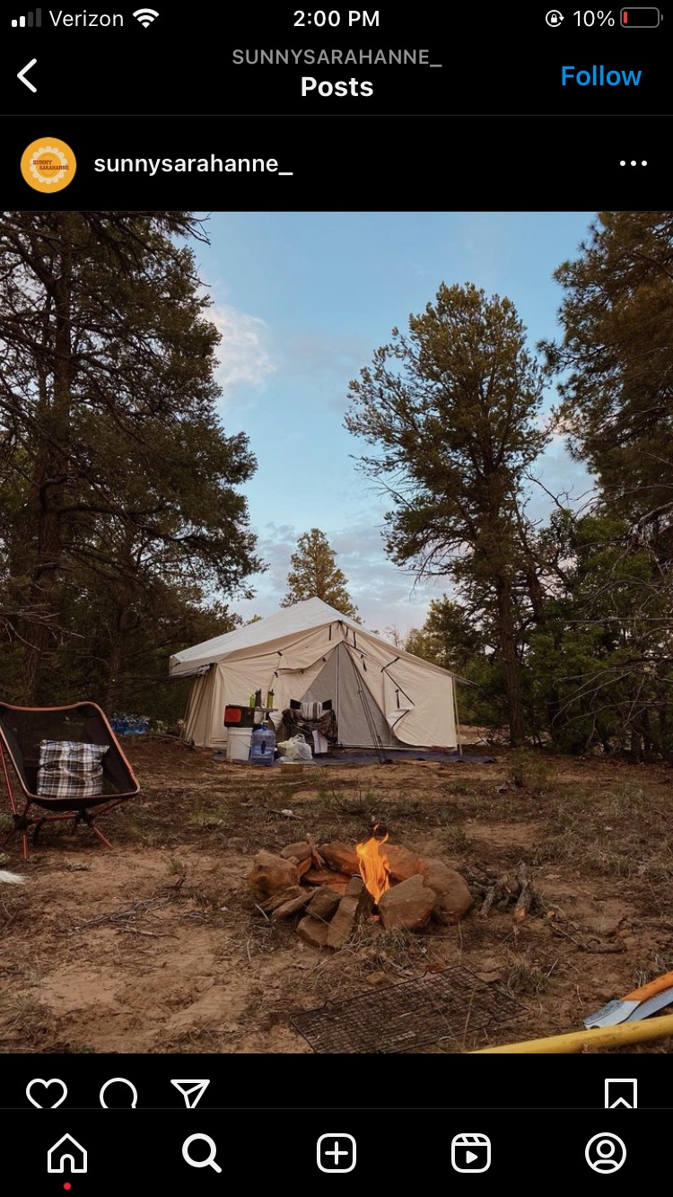
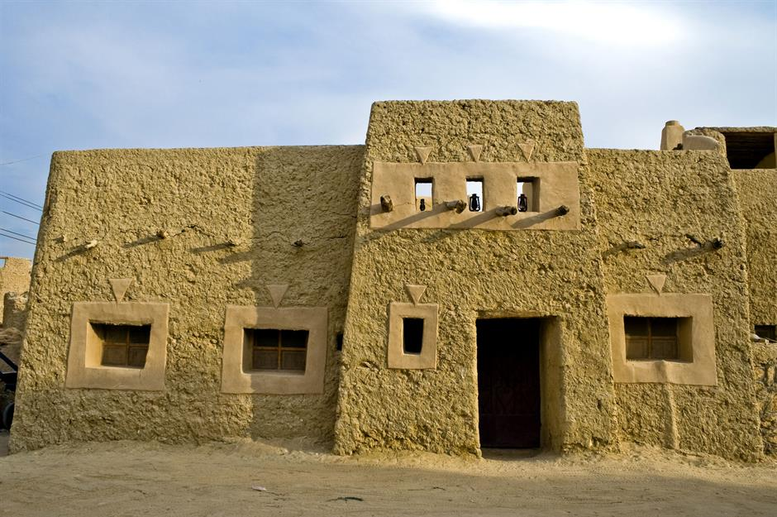

Slide 2
“6 And without faith it is impossible to please God, because anyone who comes to him must believe that he exists and that he rewards those who earnestly seek him.”
Hebrews 11:6
“The apostles said to the Lord, “Increase our faith!”
Luke 17:5

Slide 3
Abraham’s Faith: The Sojourner Living In A Tent
“He said, “I will surely return to you at this time next year; and behold, Sarah your wife will have a son.” And Sarah was listening at the tent door, which was behind him.”
Genesis 18:10
“9 By faith he made his home in the promised land like a stranger in a foreign country; he lived in tents, as did Isaac and Jacob, who were heirs with him of the same promise.”
Hebrews 11:9
“10 For he was looking forward to the city with foundations, whose architect and builder is God.”
Hebrews 11:10

Slide 4
Abraham’s Faith: The Sojourner Living In A Tent
Do I Have The Faith That Abraham Had?
“19 Their destiny is destruction, their god is their stomach, and their glory is in their shame. Their mind is set on earthly things. 20 But our citizenship is in heaven. And we eagerly await a Savior from there, the Lord Jesus Christ .”
Philippians 3:19-20
“Beloved, I urge you as sojourners and exiles to abstain from the passions of the flesh, which wage war against your soul.”
1 Peter 2:11
“So faith comes from hearing, and hearing through the word of Christ.”
Romans 10:17

Slide 5
Abraham’s Faith: The Sojourner Living In A Tent
Settler Or Sojourner?
What Am I Doing With My Time?
How Consumed Am I With Politics?
‘Am I Ready For Judgment Day?

