Slide 1
We Desperately Need Biblical Authority In A World Of Spiritual Confusion

Slide 2
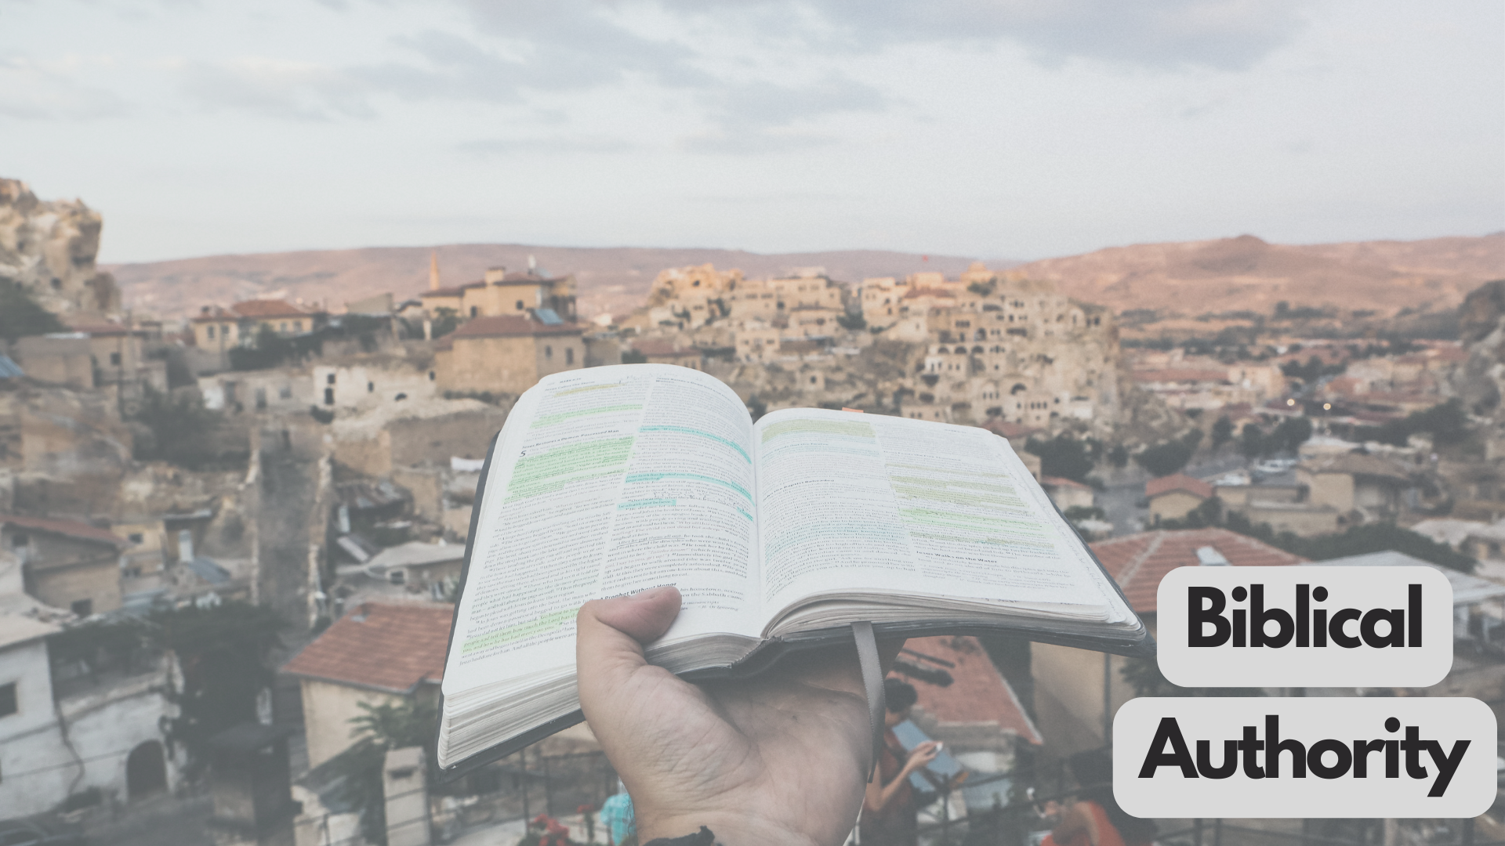
The Bible Has Authority Because:
It’s The Word Of God
“13 For this reason we also constantly thank God that when you received the word of God which you heard from us, you accepted it not as the word of men, but for what it really is, the word of God, which also performs its work in you who believe ”
1 Thessalonians 2:13
“20 But know this first of all, that no prophecy of Scripture is a matter of one’s own interpretation, 21 for no prophecy was ever made by an act of human will, but men moved by the Holy Spirit spoke from God.”
2 Peter 1:20-21
“16 All Scripture is inspired by God and profitable for teaching, for reproof, for correction, for training in righteousness; 17 so that the man of God may be adequate, equipped for every good work.”
2 Timothy 3:16-17

Slide 3
I Know It’s God’s Word Because:
Jesus Rose From The Dead & He Validated Scripture As God’s Word
Rome Couldn’t Produce A Body
The Apostles Would Not Die For A Lie

Slide 4
I Know It’s God’s Word Because:
The Evidence Regarding The Accuracy Of Modern Bibles
Pliny’s “Natural History” (61 A.D-113 A.D) has had 7 manuscripts discovered
The New Testament has a total of over 6000 Greek New Testament manuscripts discovered.
Caesar’s “Gallic Wars” (100-44 B.C) 10 manuscripts discovered
Homer’s Iliad (800 B.C.) has 2,000 manuscripts discovered

Slide 5
Because It’s The Authoritative Word Of God:
I. We Must Turn To Scripture To Know What God Wants
“Beloved, do not believe every spirit, but test the spirits to see whether they are from God, for many false prophets have gone out into the world.”
James 4:1
“All decisions and all deeds, directly or indirectly, related to what the Bible teaches, and should be determined by it ”

Slide 6
Because It’s The Authoritative Word Of God:
II. We Must Handle & Follow The Word Of God Carefully
“15 Be diligent to present yourself approved to God as a workman who does not need to be ashamed, accurately handling the word of truth.” 2 Timothy 2:15
Mishandling The Word:
Ripping Passages Out Of Context
Adding/Subtracting To The Word

Slide 7
Because It’s The Authoritative Word Of God:
II. We Must Handle & Follow The Word Of God Carefully
“Therefore, be very strong to keep and to do all that is written in the Book of the Law of Moses, turning aside from it neither to the right hand nor to the left.”
Joshua 23:6
“Not everyone who says to Me, ‘Lord, Lord,’ will enter the kingdom of heaven, but he who does the will of My Father who is in heaven will enter.”
Matthew 7:23

Slide 8
Because It’s The Authoritative Word Of God:
III. We Should Be Reading It

