Slide 2
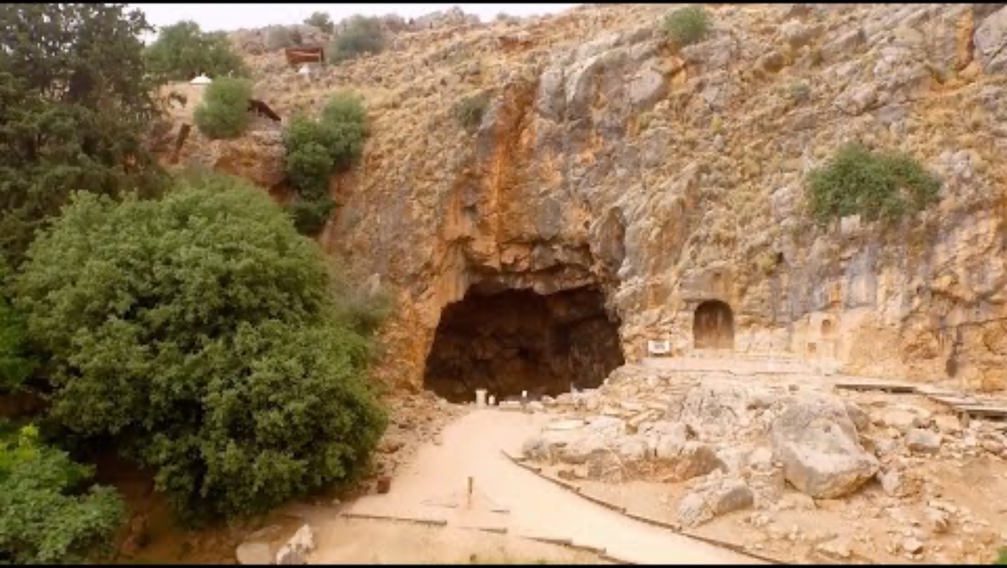
Matthew 16: Peter’s Confession Of Christ
Lessons & Observations

Slide 3
Matthew 16: Peter’s Confession Of Christ
Lessons & Observations
“In about 20 BCE, Paneas was annexed to Herod by the Emperor Augustus and Herod thereafter erected a temple at Paneas in honor of Augustus in about 19 BCE. The temple was placed in front of the Cave of Pan. The front facade had four Ionic columns supporting an unbroken pediment. And it appears that the temple did not have a back wall, but that the adyton, the small area at the far end of the temple which normally housed the image of the deity (the holy of holies) was the cave itself. This allowed animal sacrifices to Pan to be thrown directly into the chasm of the cave .”
“Caesarea Philippi was an area associated with idols and rival deities. “The area was scattered with temples of the ancient Syrian Baal worship… there rose a great hill, in which was a deep cavern; and that cavern was said to be the birthplace of the great god Pan, the god of nature…In Caesarea Philippi there was a great temple of white marble built to the godhead of Caesar…It is as if Jesus deliberately set himself against the background of the world’s religions in all their history and splendor, and demanded to be compared to them and to have the verdict given in his favor.”

Slide 4
Matthew 16: Peter’s Confession Of Christ
Lessons & Observations
Is Peter The First Pope?
“I want you to recall the words spoken in the past by the holy prophets and the command given by our Lord and Savior through your apostles.”
2 Peter 3:2
“We should understand this as Jesus giving both the permission and the authority to the first-generation apostles to make the rules for the early church – and indirectly, the inspired writings that would guide all generations of Christians. The authority that Peter carries is “not an authority which he alone carries, as may be seen from the repetition of the latter part of the verse in Matthew 18:18 with reference to the disciple group as a whole .”
“built on the foundation of the apostles and prophets, with Christ Jesus himself as the chief cornerstone…..which was not made known to people in other generations as it has now been revealed by the Spirit to God’s holy apostles and prophets .”
Ephesians 2:20; 3:5
“Paul, an apostle—sent not from men nor by a man, but by Jesus Christ and God the Father, who raised him from the dead.”
Galatians 1:1
The Other Apostles Were Given Authority (Matthew 18:18)
The Other Apostles didn’t honor Peter as Superior (Acts 15:13-22)
Peter Had To Be Rebuked (Gal 2:11-14)

Slide 5
Matthew 16: Peter’s Confession Of Christ
Lessons & Observations
Our Faith Can Grow! And Our Story Be Rewritten!
We Need To Develop A Faith That Withstands The Storms

Slide 6
Matthew 17: The Transfiguration
Lessons & Observations
“Father, I desire that they also whom You gave Me may be with Me where I am, that they may behold My glory which You have given Me; for You loved Me before the foundation of the world.”
John 17:24
“Death” Is Not The End Of The Faithful
“From this we see: “Saints long departed still alive; live in their personality; are known by their names; and enjoy near access to Christ .”
Jesus Would Soon Face The Same Fate As Elijah and Moses
The Transfiguration Is Something We All Will Witness

Slide 7
Matthew 17: The Temple Tax
Lessons & Observations
“13 Each one who crosses over to those already counted is to give a half shekel, according to the sanctuary shekel, which weighs twenty gerahs. This half shekel is an offering to the Lord. 14 All who cross over, those twenty years old or more, are to give an offering to the Lord. 15 The rich are not to give more than a half shekel and the poor are not to give less when you make the offering to the Lord to atone for your lives. 16 Receive the atonement money from the Israelites and use it for the service of the tent of meeting. It will be a memorial for the Israelites before the Lord, making atonement for your lives .”
Exodus 30:13-16

